Slide 1
HOME AUTOMATION
Department of Information Technology
Sameer Saxena
(RA1411008010336)

Slide 2
Overview of Project
This Project mainly focuses on the Basics of IoT, the protocols, communication medium, approaches of IoT and IoT service providers. Also it teaches the basics of Raspberry Pi.
About the Project:
In this project we used Raspberry pi to control Led’s wirelessly. The ’thing’ here were the led. The medium used was Wi-Fi or can be telephone. One could wirelessly control the led using phone of desktop and even from a far off place.

Slide 3
What is Iot?
The Internet of Things (IoT) is the network of physical objects or "things" embedded with electronics, software, sensors, and network connectivity, which enables these objects to collect and exchange data.

Slide 4
How IoT Works?
The Internet of Things (IoT), also sometimes referred to as the Internet of Everything (IoE), consists of all the web-enabled devices that collect, send and act on data they acquire from their surrounding environments using embedded sensors, processors and communication hardware. These devices, often called "connected" or "smart" devices, can sometimes talk to other related devices, a process called machine-to-machine (M2M) communication, and act on the information they get from one another. Humans can interact with the gadgets to set them up, give them instructions or access the data, but the devices do most of the work on their own without human intervention

Slide 5
Medium of communication between ‘things’
Devices must communicate with each other. Device data then must be collected and sent to the server infrastructure . That server infrastructure has to share device data , possibly providing it back to devices, to analysis programs, or to people. Some of the protocols are.
Wi-Fi
Cellular
Bluetooth
NFC

Slide 6
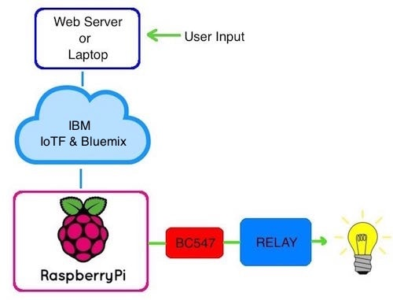
Raspberry Pi and IOt
So what is the use of Raspberry Pi in IOT? The answer is quite simple, Rasp-berry Pi is one of the key learning platforms for’
IoT. The RasPi is a popular
platform because it offers a
complete Linux server in a
tiny platform for a very
low cost.

Slide 7
Blinky Led:- Simple IOT Project
We create a simple IoT project to control the Led wirelessly.
The details of project are:
Things : Leds
Protocols : Wi-Fi
Hardware used: Raspberry Pi
Software’s used: Raspbian OS

Slide 8
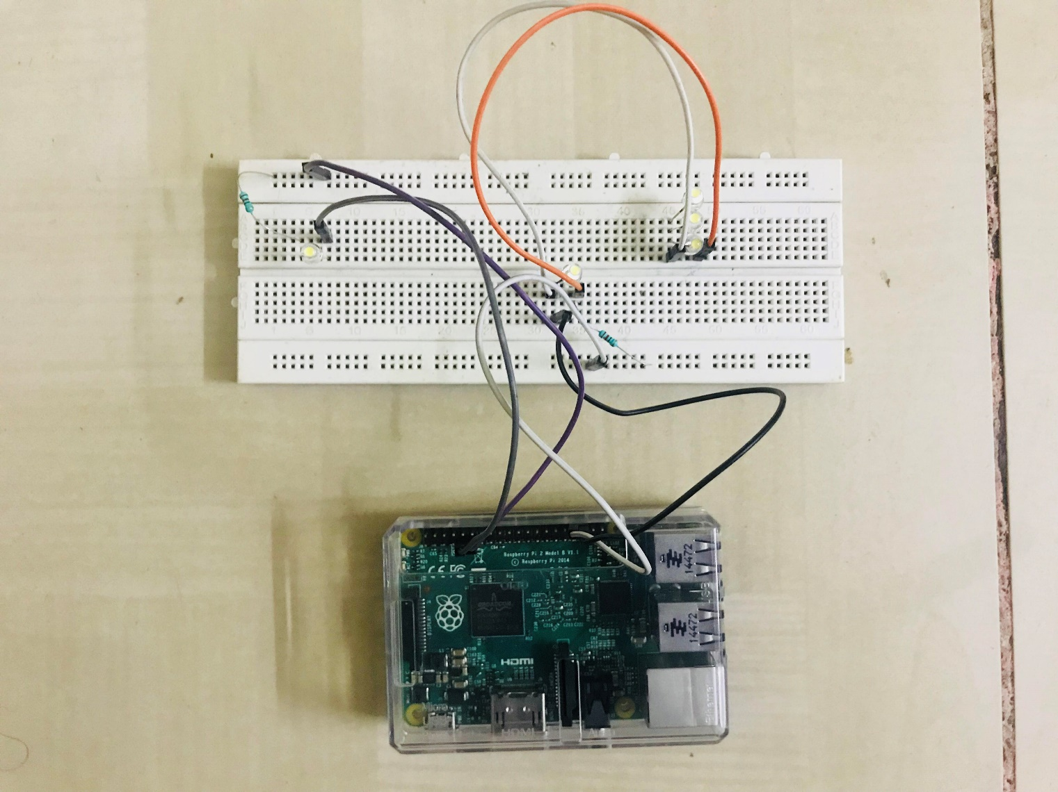
Screenshots
The basic setup of led on Bread-board. We have used 6th and 18th GPIO pins for leds. The whole setup is connected to Pi and the Pi is then connected to router via LAN wire.

Slide 9
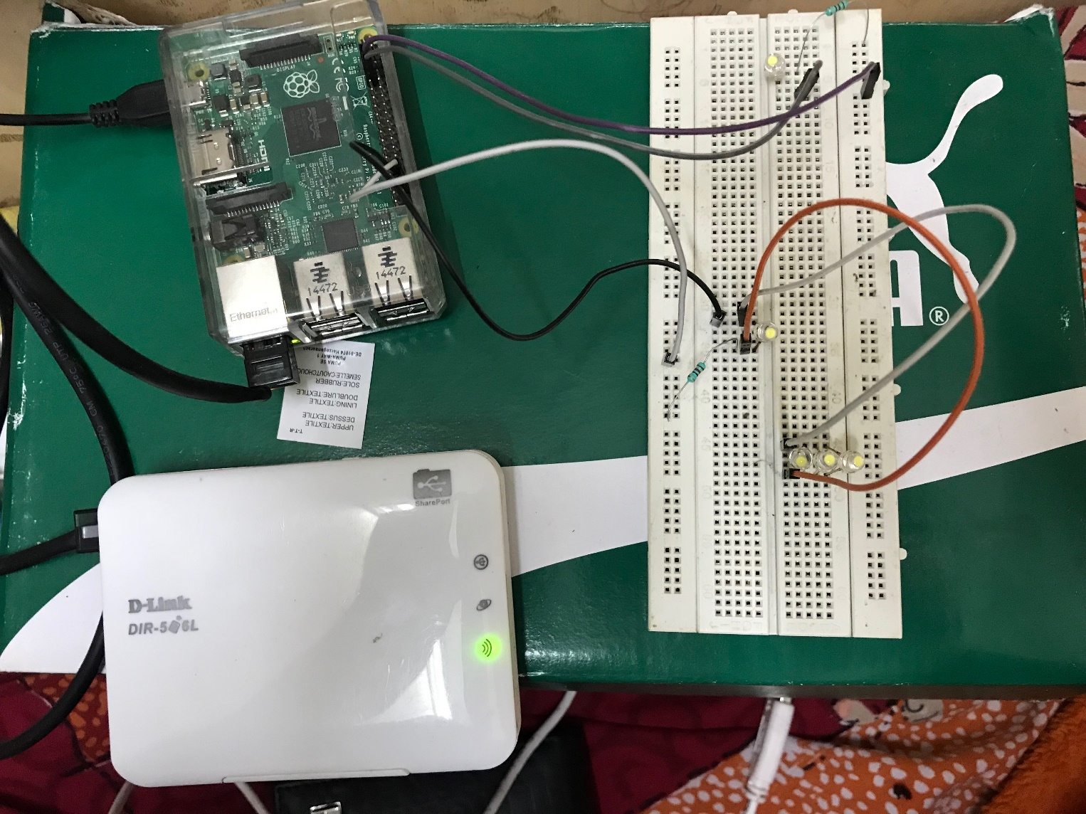
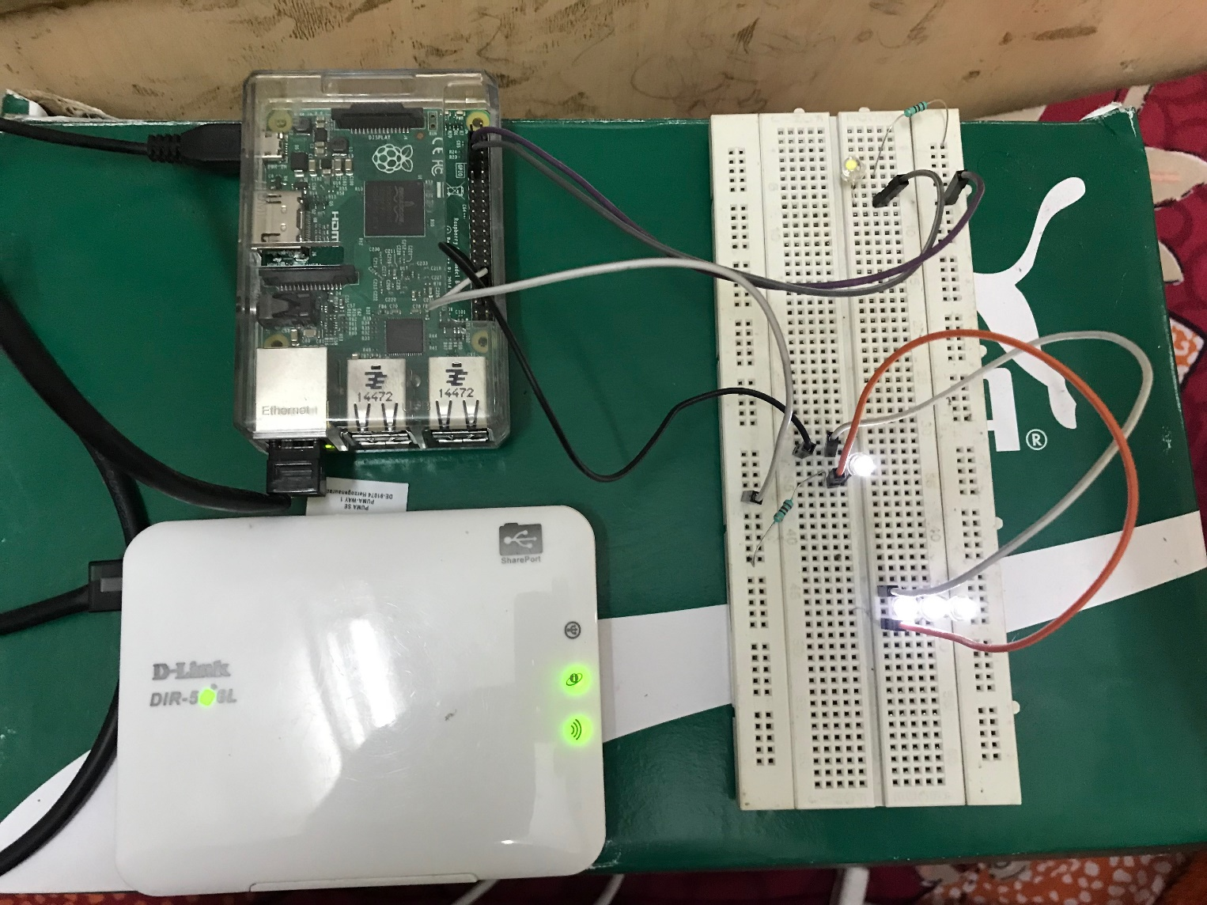
The setup before and after triggering the on off switch
Before Switch On
After Switch On

Slide 10

Implemented on large scale
In this I took a home bulb with the same line of code
I attached a bulb and Relay.
Hence using app MOBILE SSH or through my laptop
I was able to switch on and off the bulb.
In this instead of using a router I connected it with the
Telephone Lan Cable and it was still working

Slide 11
If I take the project on large scale
If I take the project on large Scale I can implement the same home automation
On My house light switches
I can even connect it with my smart Tv and also my AC at home so that whenever
I reach home the room is already chilled

